Slide 1
STORM: a Scalable Toolkit for an Open Community Supporting Near Real-time High Resolution Coastal Storm Modeling
Hartmut Kaiser¹, Joannes Westerink², Rick Luettich³, Clint Dawson⁴
¹Louisiana State University, ²University of Notre Dame, ³University of North Carolina at Chapel Hill,
⁴University of Texas at Austin
NSF SI2 PI Meeting
April 30 - May 1, 2018

Slide 2
The hydrodynamics of the coastal ocean and floodplain
Understanding coastal sustainability and risk means understanding
water levels, currents, and wind waves

Slide 3
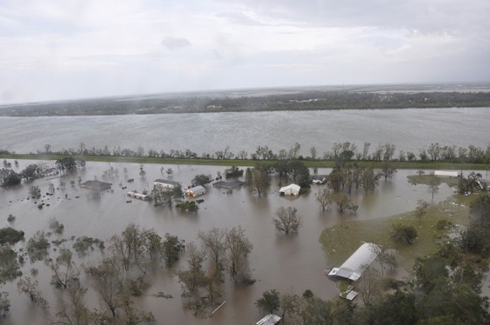
The hydrodynamics of the coastal ocean and floodplain
Understanding coastal sustainability and risk means understanding
water levels, currents, and wind waves
Coastal flooding

Slide 4
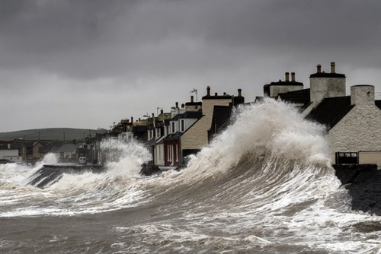
The hydrodynamics of the coastal ocean and floodplain
Understanding coastal sustainability and risk means understanding
water levels, currents, and wind waves
Coastal flooding
Wave forces

Slide 5
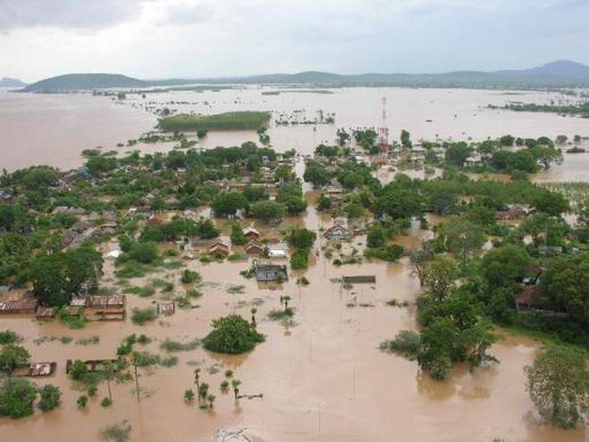
The hydrodynamics of the coastal ocean and floodplain
Understanding coastal sustainability and risk means understanding
water levels, currents, and wind waves
Coastal flooding
Wave forces
Sinking deltas

Slide 6
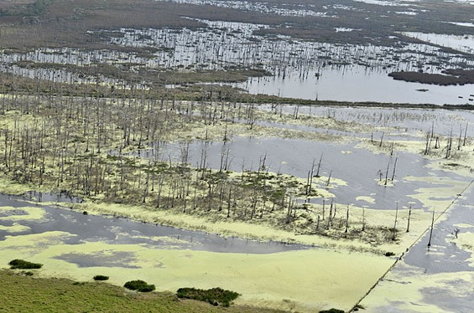
The hydrodynamics of the coastal ocean and floodplain
Understanding coastal sustainability and risk means understanding
water levels, currents, and wind waves
Coastal flooding
Wave forces
Sinking deltas
Wetland degradation

Slide 7
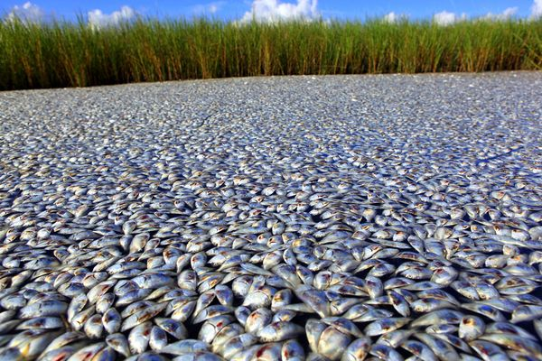
The hydrodynamics of the coastal ocean and floodplain
Understanding coastal sustainability and risk means understanding
water levels, currents, and wind waves
Coastal flooding
Wave forces
Sinking deltas
Wetland degradation
Coastal dead zones

Slide 8
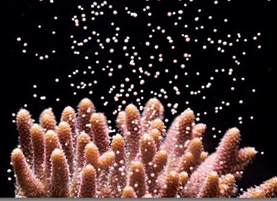
The hydrodynamics of the coastal ocean and floodplain
Understanding coastal sustainability and risk means understanding
water levels, currents, and wind waves
Coastal flooding
Wave forces
Sinking deltas
Wetland degradation
Coastal dead zones
Marine larval transport

Slide 9
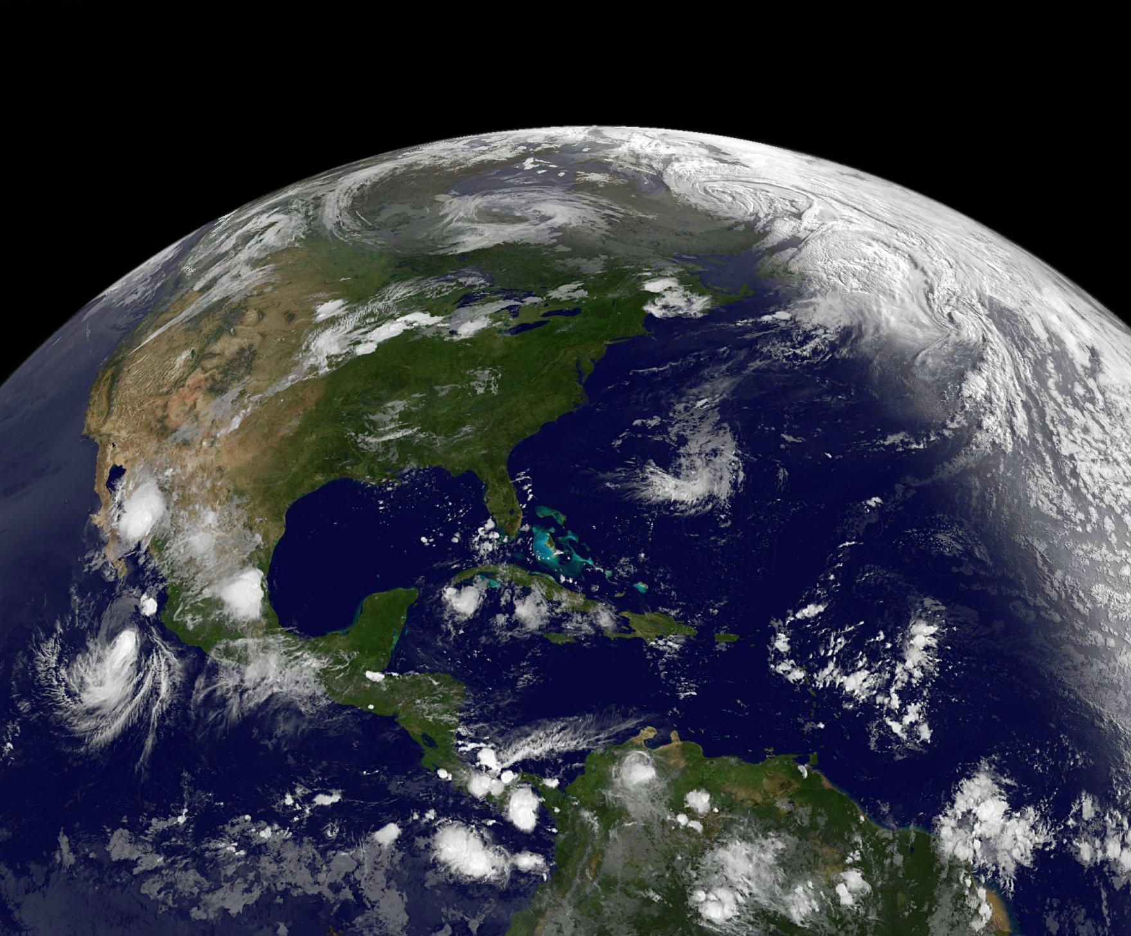
Processes in the ocean and coastal floodplain

Slide 10
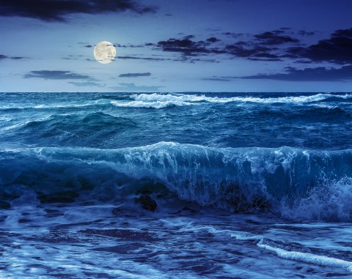
Processes in the ocean and coastal floodplain
Tides

Slide 11
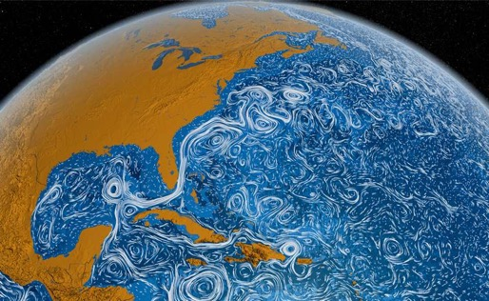
Processes in the ocean and coastal floodplain
Tides
Global Ocean Circulation

Slide 12
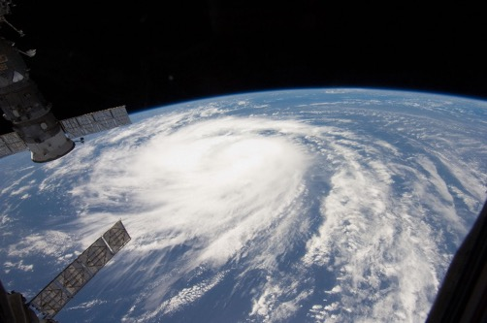
Processes in the ocean and coastal floodplain
Tides
Global Ocean Circulation
Storms

Slide 13
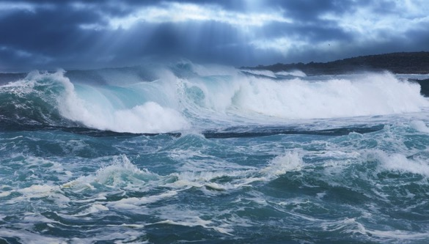
Processes in the ocean and coastal floodplain
Tides
Global Ocean Circulation
Waves
Storms

Slide 14
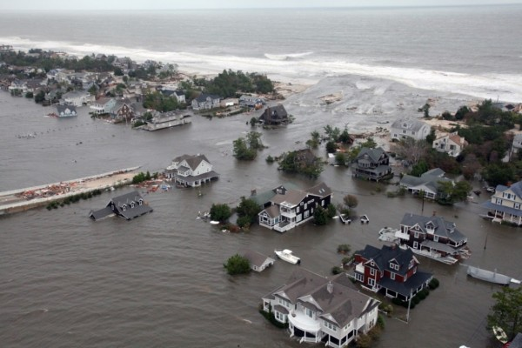
Processes in the ocean and coastal floodplain
Tides
Storm surges
Global Ocean Circulation
Waves
Storms

Slide 15
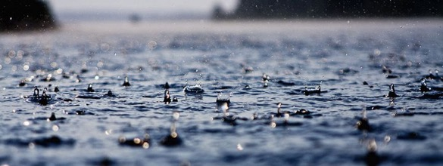
Processes in the ocean and coastal floodplain
Rainfall Runoff
Tides
Storm surges
Global Ocean Circulation
Waves
Storms

Slide 16
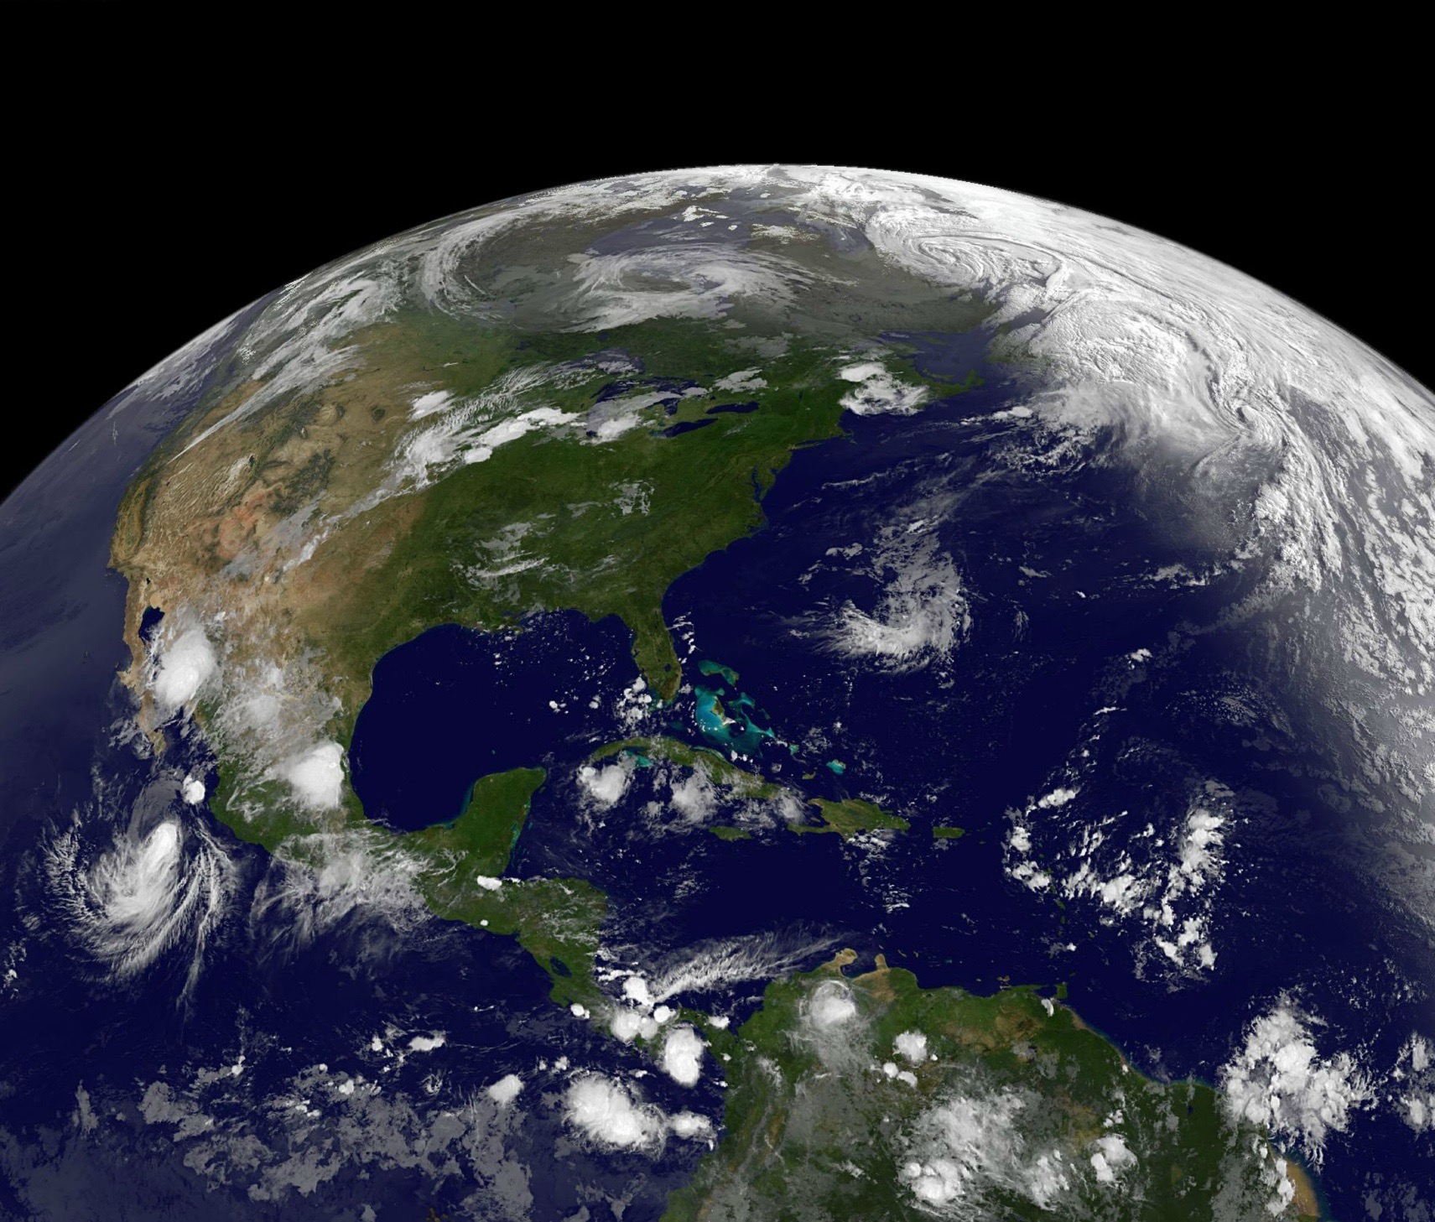
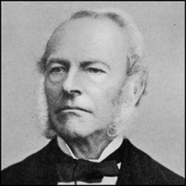
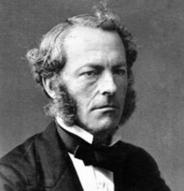
Processes in the ocean and coastal floodplain
Rainfall Runoff
Navier Stokes Equations (1822)
Mass & momentum conservation
Describes all processes
Solve for 10³⁴ unknowns per day of real time
Tides
Storm surges
Global Ocean Circulation
Waves
Storms

Slide 17
Processes in the ocean and coastal floodplain
Rainfall Runoff
Process & Scale Separation
Shallow water equations
Boussinesq equations
Spectral action balance equation
Kinematic wave equation
Dynamic wave equations
Prognostic ocean circulation
equations
Reynolds Averaged Navier Stokes
Tides
Storm surges
Global Ocean Circulation
Waves
Storms

Slide 18
Processes in the ocean and coastal floodplain
Rainfall Runoff
Domain & Resolution Separation
Provide affordable resolution
for domain size and alias the rest
Nesting
Data assimilate for missing physics
and scales
Tides
Storm surges
Global Ocean Circulation
Waves
Storms

Slide 19
Evolution of coastal ocean hydrodynamics models – the past
The GOOD
Better resolution
Better algorithms
Better physics of sub-grid scale
More component interaction
Unstructured grids focusing on localized resolution
Improving parallelism
The BAD
Largely siloed development with disparate communities
Sub-optimal grids
Largely second order or lower
Often inefficient parallel processing

Slide 20
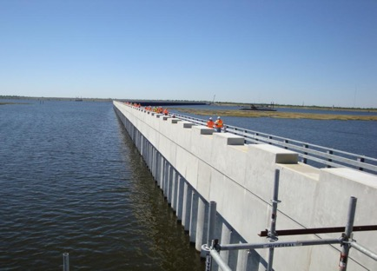
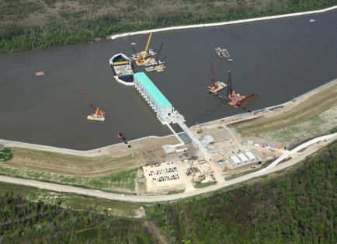
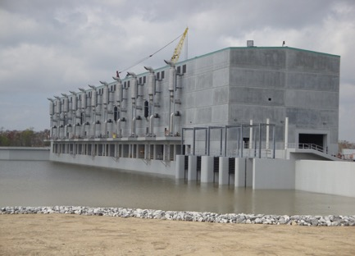
ADCIRC+SWAN: Coastal ocean circulation and wave models – the past
ADCIRC solves the shallow water equations in 2D and 3D
ADCIRC applies Galerkin FEM using highly unstructured linear finite element grids over large ocean domains
ADCIRC usage highlights in U.S.
USACE: Design Metropolitan New Orleans levees post Katrina; Post Sandy flood risk study along East and Texas coasts
NOAA: Extra-tropical real time forecasting models (ESTOFS)
FEMA: Flood Insurance Studies for U.S. Gulf, East and Great Lakes coasts
NRC: Nuclear power station risk evaluation

Slide 21
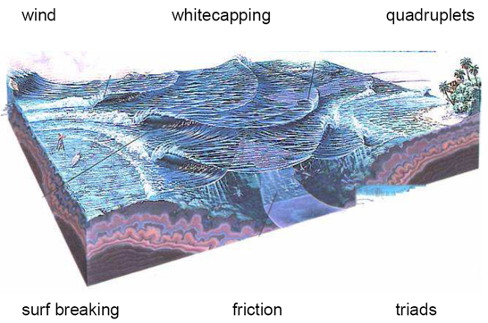
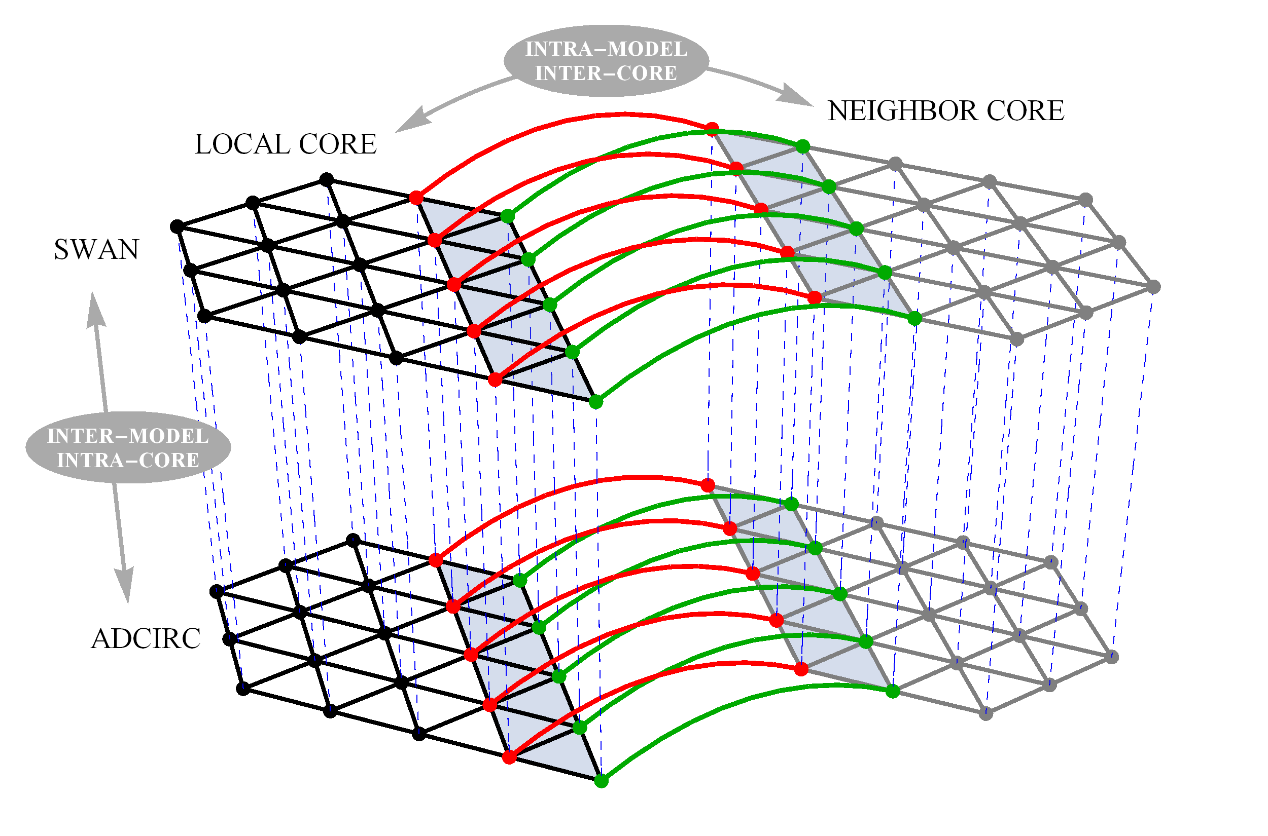
Codes: SWAN+ADCIRC – Coupled waves and current on identical unstructured grids
ADCIRC+SWAN: Coastal ocean circulation and wave models – the past
SWAN solves the wave action density and is a non-phase resolving wave model with wave energy represented by a spectrum
SWAN has been implemented as an unstructured grid model with the degrees of freedom at triangle vertices
ADCIRC and SWAN interact
Water levels and currents affect waves
Wave breaking forces water level setup and currents
Dietrich et al., Coastal Engineering, 58, 45-65, 2011.
Dietrich et al., Journal of Scientific Computing, 52, 468-497 2012.

Slide 22
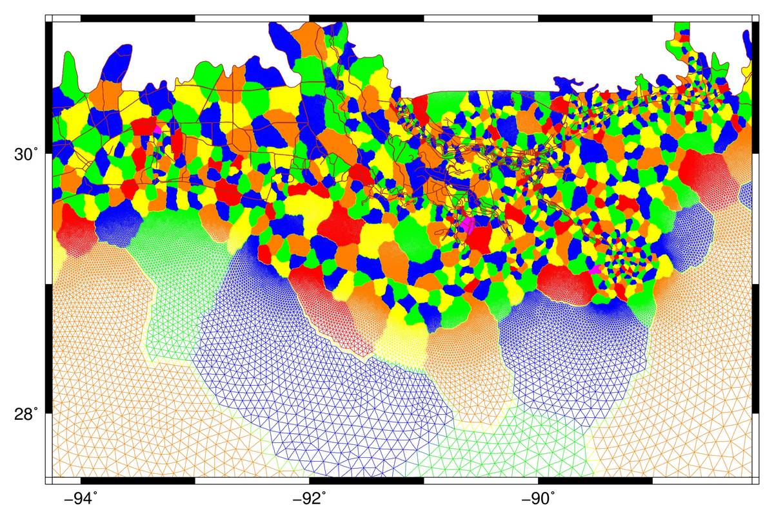
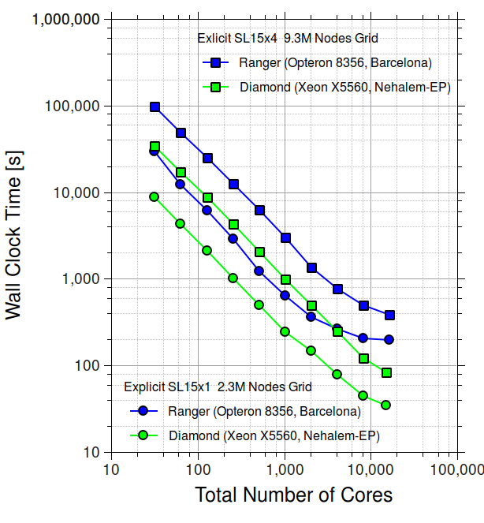
ADCIRC+SWAN: Coastal ocean circulation and wave models – the past
HPC: MPI Based Domain Decomposition – Overlapping Element Layer Node to Node Communication
HPC: Parallel Performance
SL15v7l Grid Decomposition on 1024 Cores

Slide 23
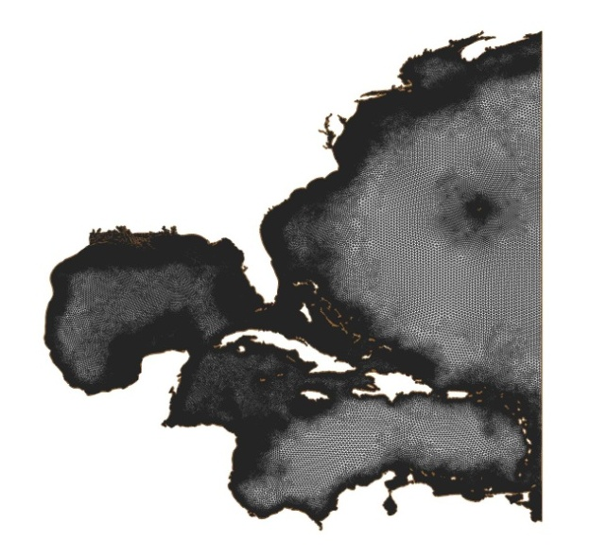
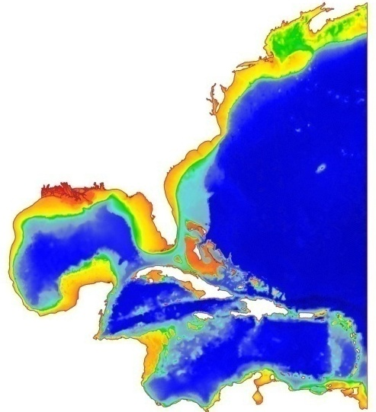
ADCIRC+SWAN: Coastal ocean circulation and wave models – the past
SL16v18 model bathymetry and topography and unstructured mesh
Martyr et al., Journal of Hydraulic Engineering, 139, 5, 492-501, 2013.
Hope et al., Journal of Geophysical Research: Oceans, 118, 4424-4460, 2013.
Kerr et al., Journal of Geophysical Research: Oceans, 118, 5129–5172, 2013.
Dietrich et al., Monthly Weather Review, 139, 2488-2522, 2011.
Kennedy et al., Geophysical Research Letters, 38, L08608, 2011.
Kerr et al., Journal of Waterway, Port, Coastal, and Ocean Engineering, 139, 326-335, 2013.

Slide 24
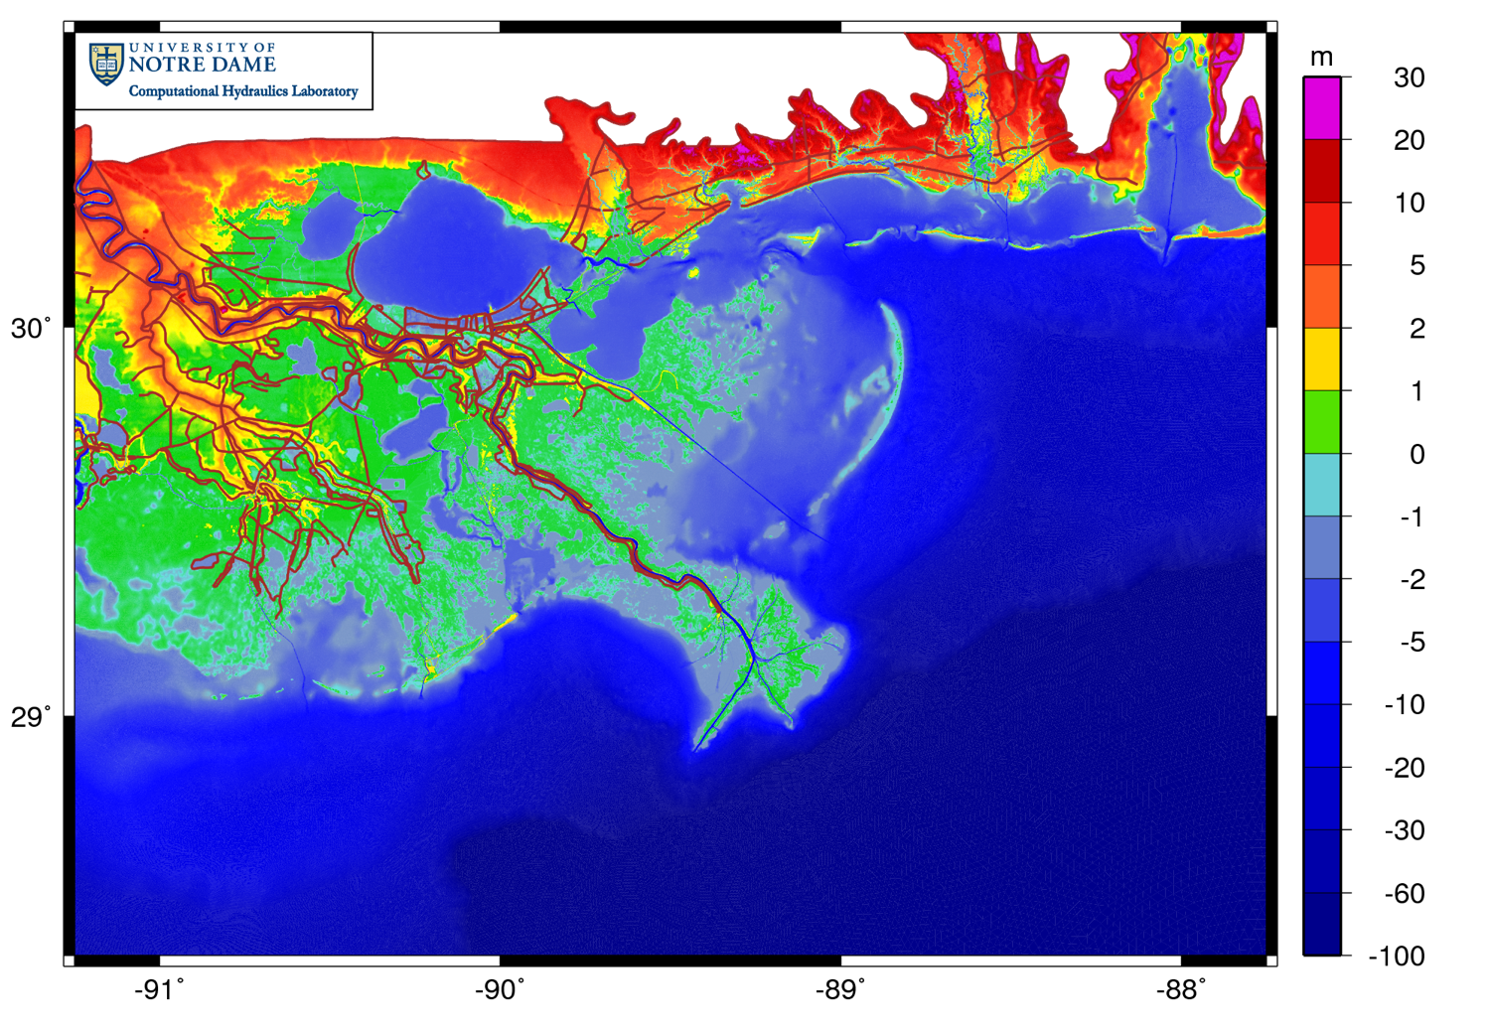
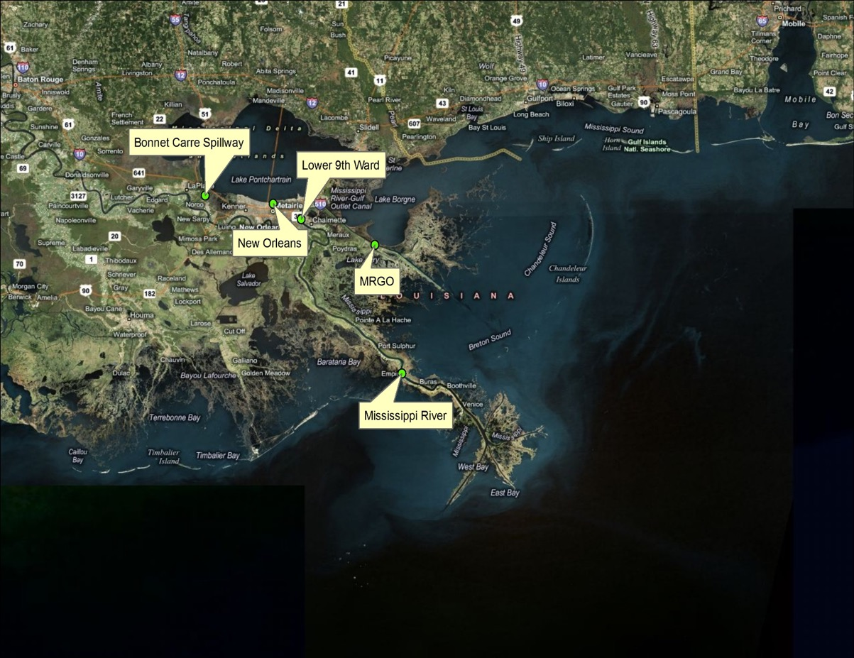
SL16v18 model bathymetry & topography in SE Louisiana

Slide 25
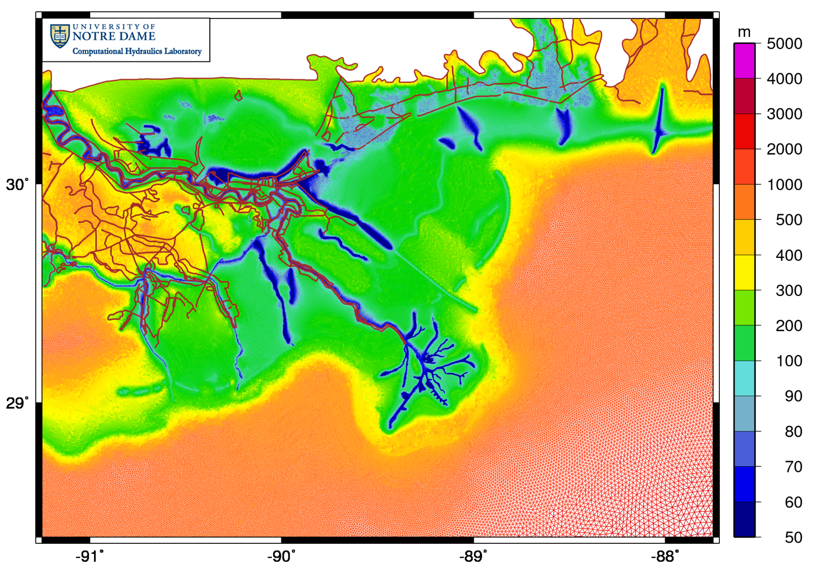
Models: SL16v18 mesh size in SE Louisiana

Slide 26
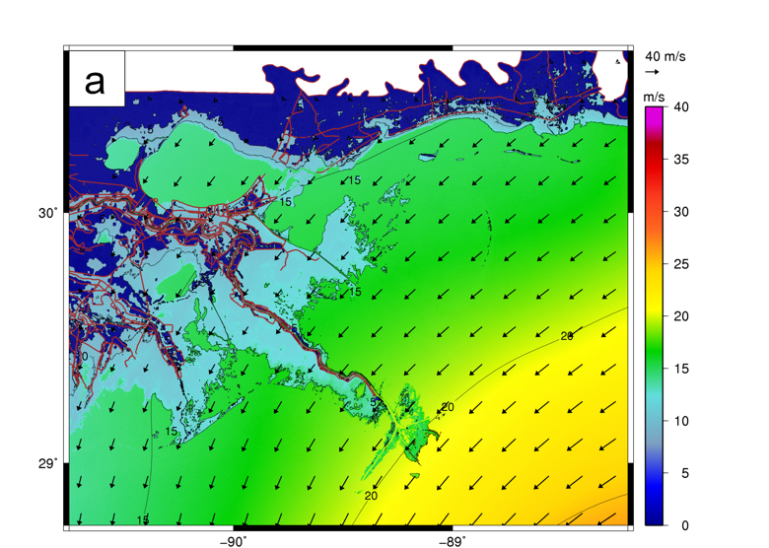
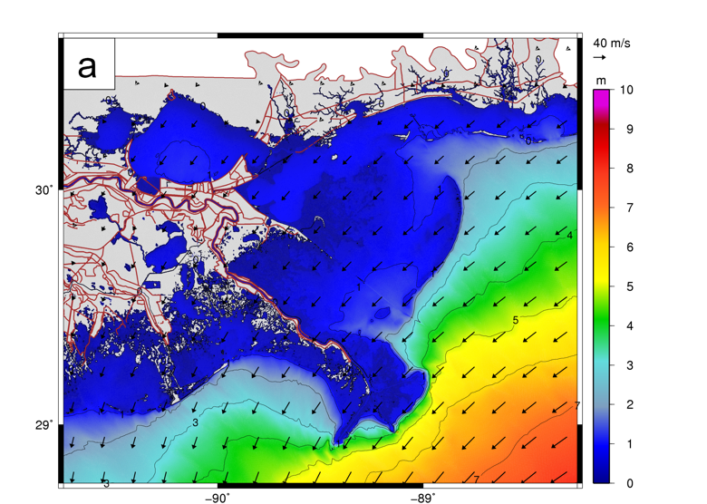
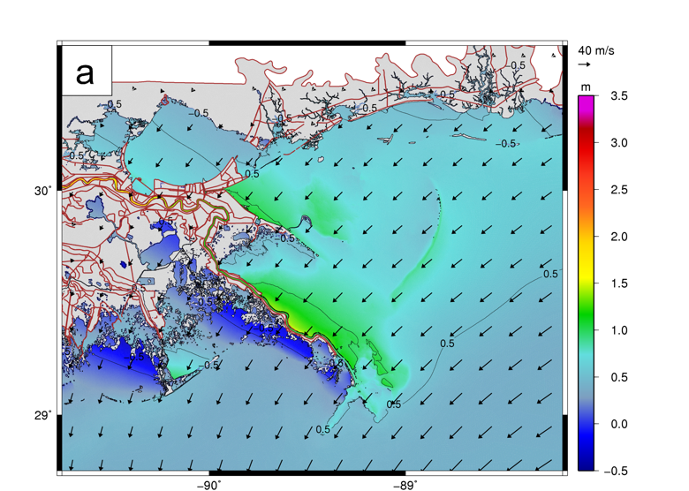
Hurricane Gustav: 2008 / 09 / 01 / 0200 UTC
Winds (m/s) Waves (m) Water Elevations (m)
Dietrich et al., Monthly Weather Review, 139, 2488-2522, 2011.

Slide 27
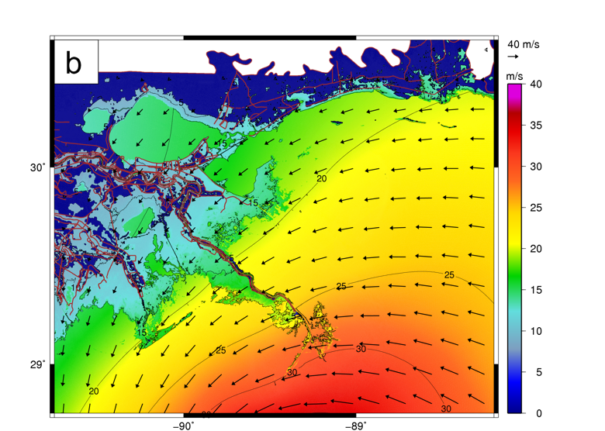
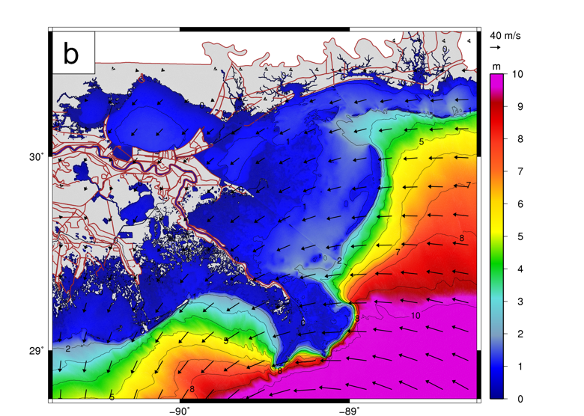
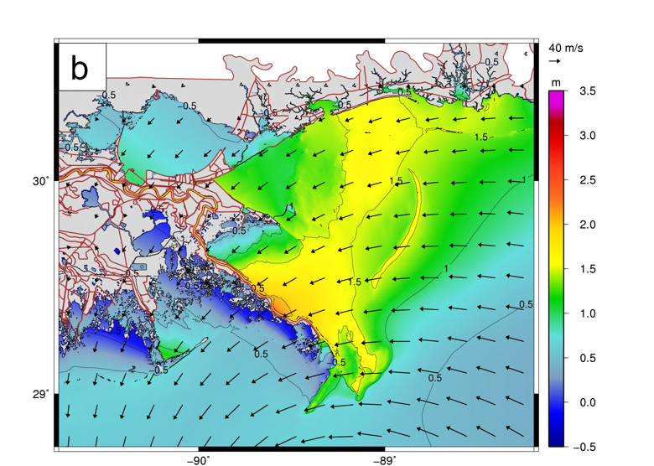
Hurricane Gustav: 2008 / 09 / 01 / 0800 UTC
Winds (m/s) Waves (m) Water Elevations (m)
Dietrich et al., Monthly Weather Review, 139, 2488-2522, 2011.

Slide 28
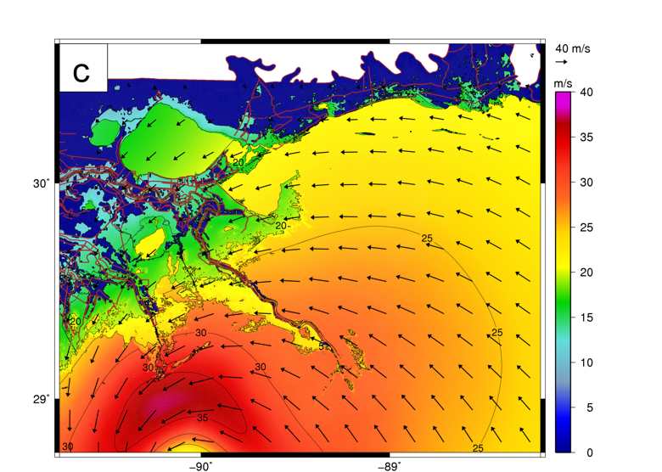
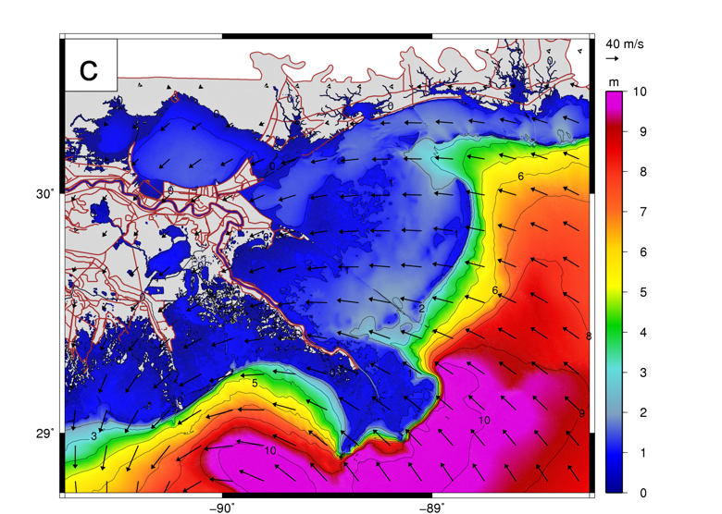
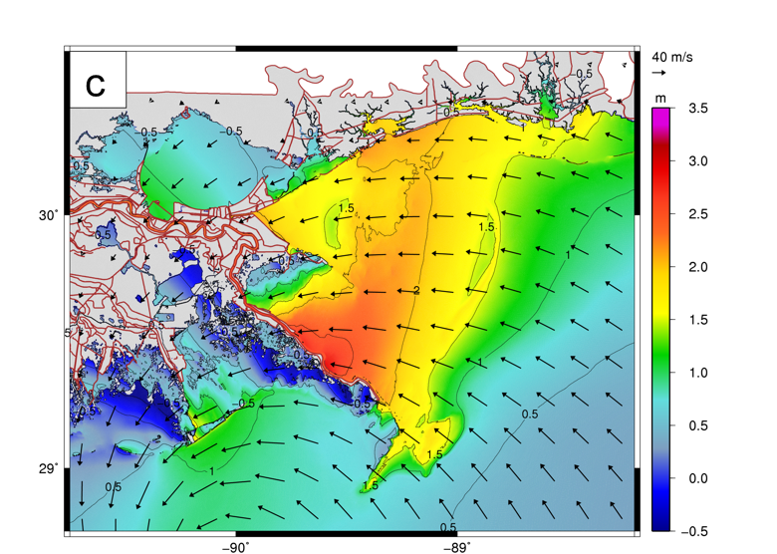
Hurricane Gustav: 2008 / 09 / 01 / 1100 UTC
Winds (m/s) Waves (m) Water Elevations (m)
Dietrich et al., Monthly Weather Review, 139, 2488-2522, 2011.

Slide 29
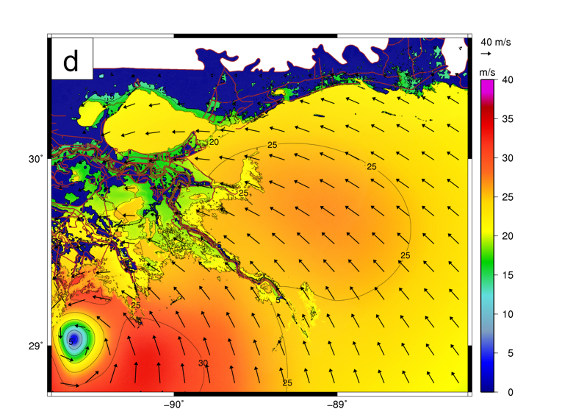
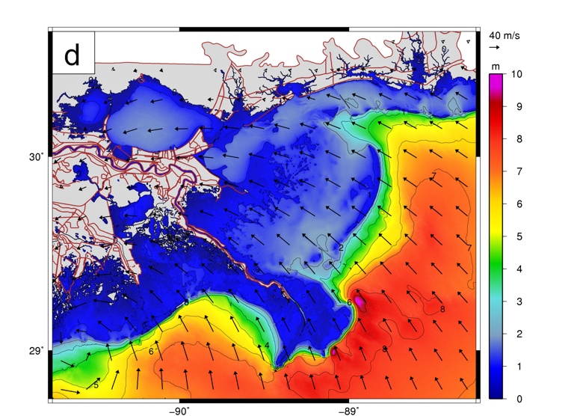
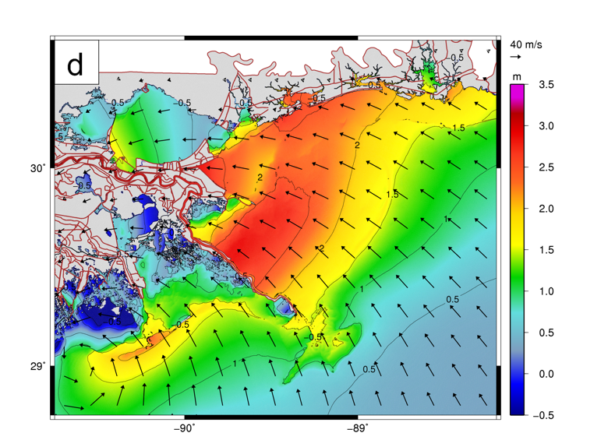
Hurricane Gustav: 2008 / 09 / 01 / 1400 UTC
Winds (m/s) Waves (m) Water Elevations (m)
Dietrich et al., Monthly Weather Review, 139, 2488-2522, 2011.

Slide 30
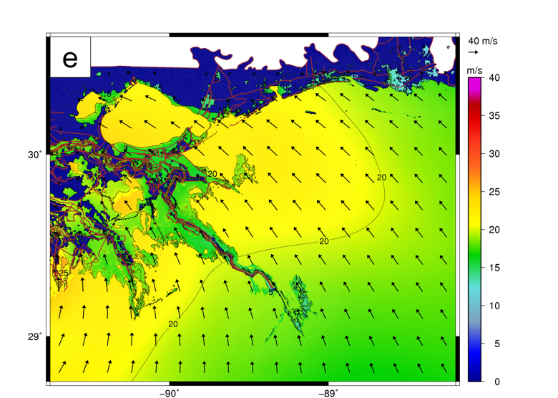
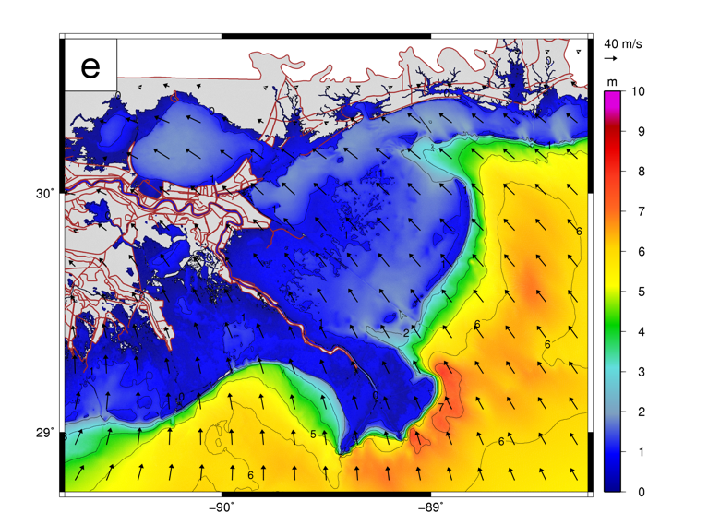
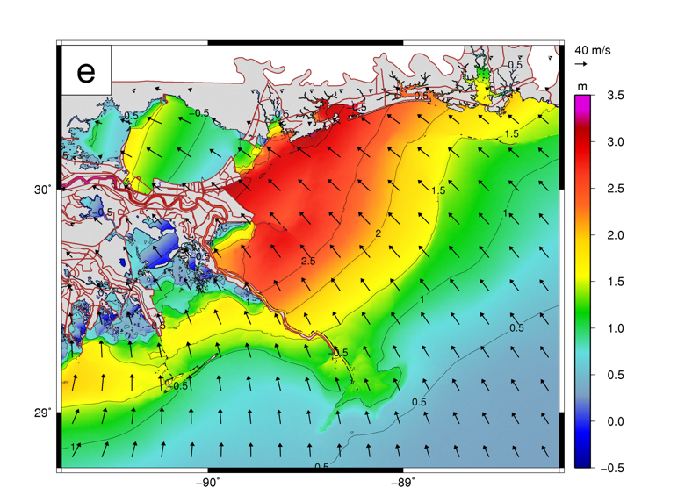
Hurricane Gustav: 2008 / 09 / 01 / 1700 UTC
Winds (m/s) Waves (m) Water Elevations (m)
Dietrich et al., Monthly Weather Review, 139, 2488-2522, 2011.

Slide 31
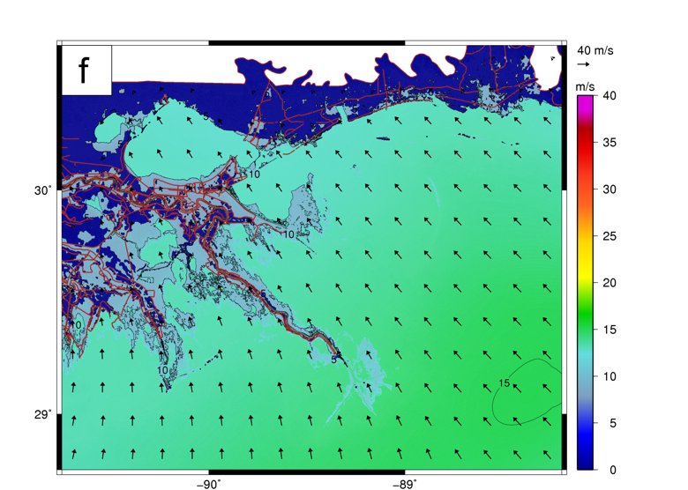
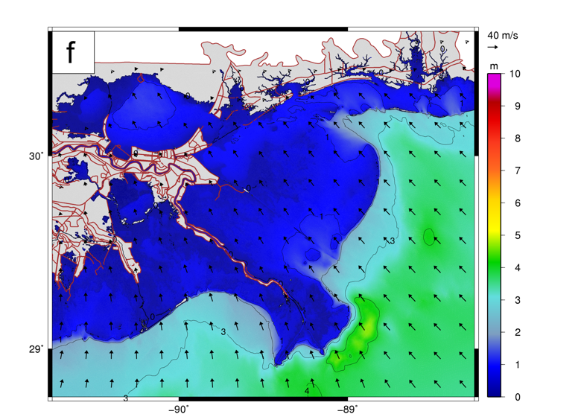
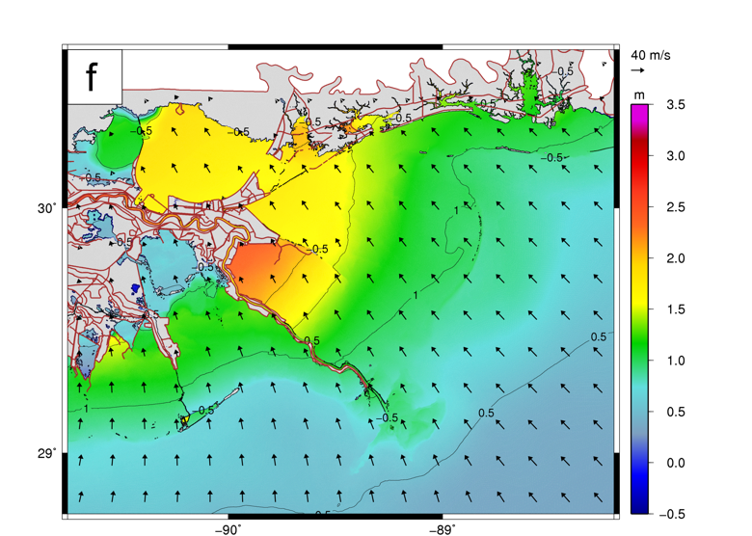
Hurricane Gustav: 2008 / 09 / 02 / 0200 UTC
Winds (m/s) Waves (m) Water Elevations (m)
Dietrich et al., Monthly Weather Review, 139, 2488-2522, 2011.

Slide 32
Evolution of coastal ocean hydrodynamic models – the present
The GOOD
Advancing higher and more targeted resolution
High order algorithms
Advancing integration and interleafing component interactions
The BAD
Still largely static grids that are costly to generate
Static physics
Poor load balance on component computations
Falling peak processor performance

Slide 33
Evolution of Coastal Ocean Hydrodynamic Models – the present
Dynamic ADCIRC, SWAN & HYCOM Interleafing
CFSv2 Global Atmospheric Model
ADCIRC 2D Western North Atlantic
SWAN Wave Energy Density
HYCOM 3D Global Circulation Model

Slide 34
Evolution of coastal ocean hydrodynamic models – the future
Vision
Fully dynamic computations that during the simulation select
grid resolution
order of interpolants
load balance
physics
Focus areas
Dynamic grid optimization for multi-physics
High order methods
Advance engines for load balancing
Develop frameworks that allow dynamic and coupled physics

Slide 35
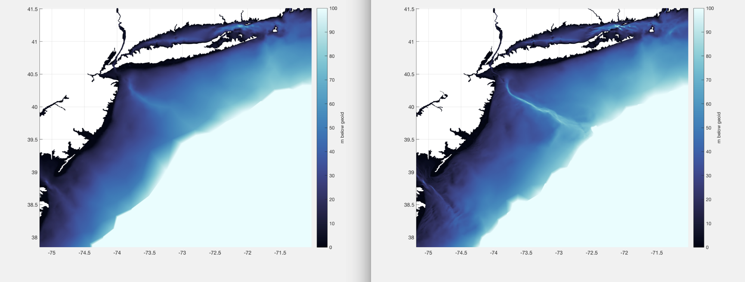
Lower energy tides
Dynamic grid optimization for evolving physics
High energy storm driven circulation

Slide 36
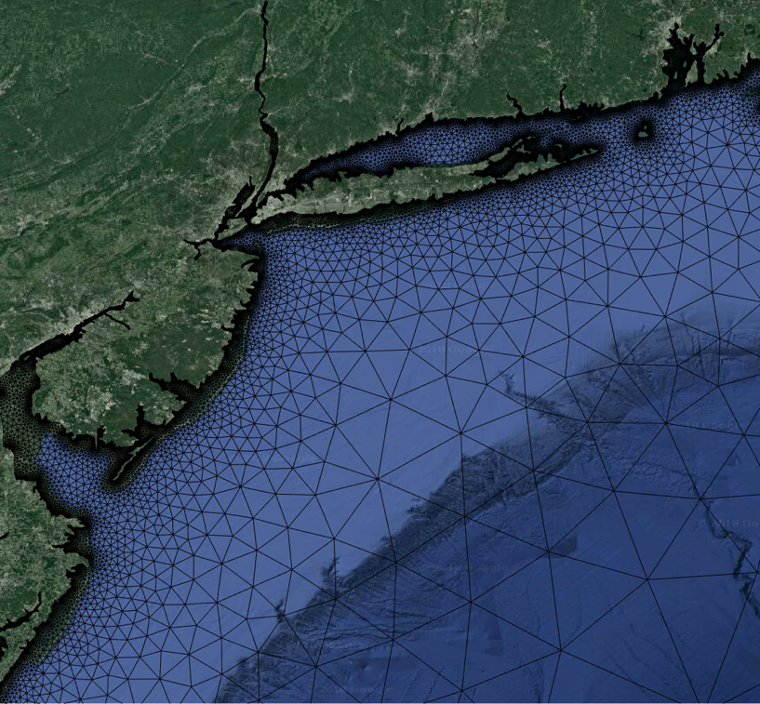
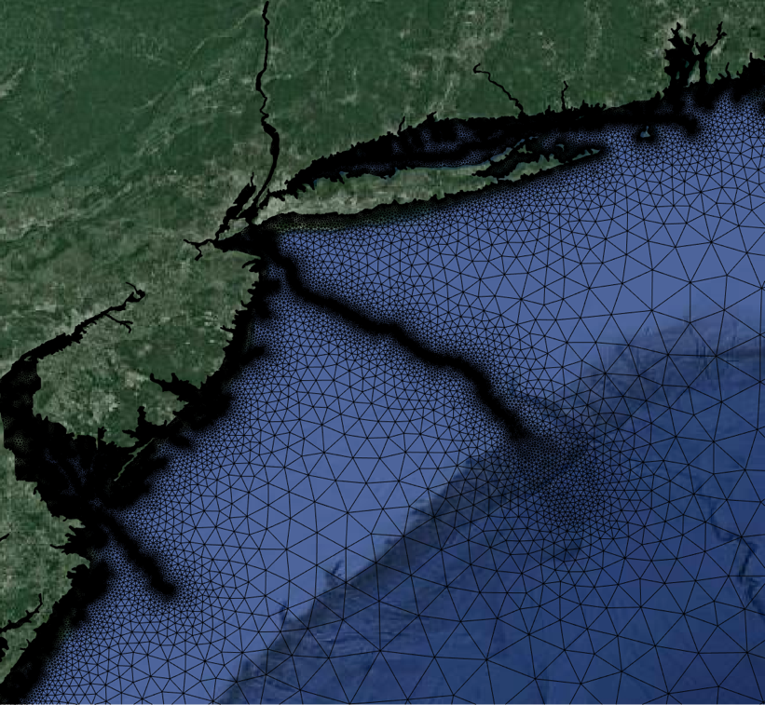
Lower energy tides
Dynamic grid optimization for evolving physics
High energy storm driven circulation

Slide 37
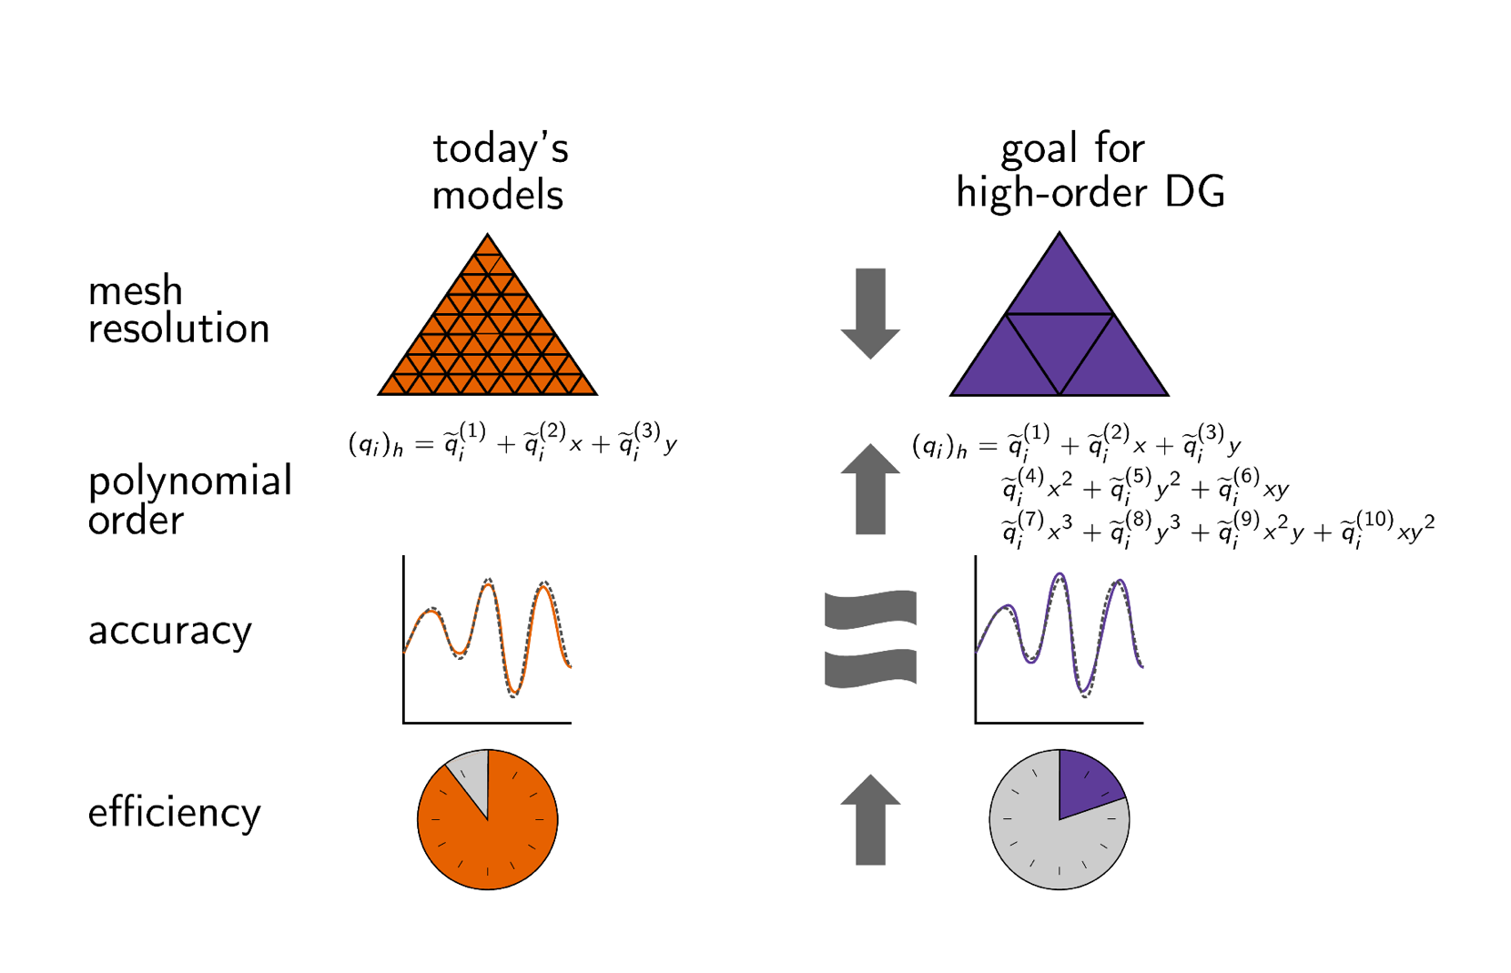
High order interpolants

Slide 38
High order interpolants
Discontinuous Galerkin (DG) allows for non-conforming h-p dynamic adaptation
High-resolution ADCIRC
High-order DG (p=3)
Low-resolution ADCIRC
Runs 4 x faster
Poor solutions

Slide 39
Dynamic load balancing: MPI/Zoltan
Dry
Wet
Dry
dry
Dry
Wet
Wet

Slide 40
Dynamic load balancing: MPI/Zoltan
Equal node distribution
Weighted node distribution
Nodal data structure
Dynamically redistributing dry elements improves parallel efficiency
45% for 50% average dry nodes

Slide 41
Dynamic load balancing: HPX
Motivation: Exa-scale, heterogeneous architectures, post Moore’s Law computing
General purpose C++ runtime system for parallel and distributed applications
Open source implementation of the ParalleX execution model to overcome:
Starvation
Latencies
Overhead
Waiting
Exposes C++11 standard conforming API
Innovative mixture of:
A global system-wide address space (AGAS)
Fine-grain parallelism and lightweight synchronization
Implicit, work queue based, message driven computation
Full semantic equivalence of local and remote execution
Explicit support for hardware accelerators and vectorization

Slide 42
Dynamic load balancing: HPX
MPI vs. HPX comparison with C++ DG shallow water equation solver
Knights Landing
Skylake
MPI eventually outperforms HPX
HPX performance depends on managing task granularity
Strong
Scaling
HPX Task Composition
HPX task scheduling is more expensive on KNL.
HPX achieves a 1.25x – 1.21x speedup over MPI
Weak
Scaling

Slide 43
Develop dynamic hydrodynamic equation selection frameworks
CFSv2 Global Atmospheric Model
ADCIRC DG VO 2D/3D North Atlantic
2D SWE
2D SWE + Pressure Poisson Solver
3D SWE
2D Kinematic wave model
2D Dynamic wave model
WAVEWATCH III Wave Energy
HYCOM 3D Global Circulation Model
CICE Global Sea Ice Model
WRF Hydro National Water Model

Slide 44
Dynamic hydrodynamic equation selection
CFSv2 Global Atmospheric Model
ADCIRC DG variable p
ADCIRC DG VO 2D/3D North Atlantic
2D SWE
2D SWE + Pressure Poisson Solver
3D SWE
2D Kinematic wave model
2D Dynamic wave model
WAVEWATCH III Wave Energy
HYCOM 3D Global Circulation Model
CICE Global Sea Ice Model
WRF Hydro National Water Model

Slide 45
Dynamic hydrodynamic equation selection
CFSv2 Global Atmospheric Model
ADCIRC DG VO 2D/3D North Atlantic
2D SWE
2D SWE + Pressure Poisson Solver
3D SWE
2D Kinematic wave model
2D Dynamic wave model
WAVEWATCH III Wave Energy
HYCOM 3D Global Circulation Model
CICE Global Sea Ice Model
WRF Hydro National Water Model

Slide 46
Dynamic hydrodynamic equation selection
CFSv2 Global Atmospheric Model
ADCIRC DG VO 2D/3D North Atlantic
2D SWE
2D SWE + Pressure Poisson Solver
3D SWE
2D Kinematic wave model
2D Dynamic wave model
WAVEWATCH III Wave Energy
HYCOM 3D Global Circulation Model
CICE Global Sea Ice Model
WRF Hydro National Water Model

Slide 47
Dynamic hydrodynamic equation selection
CFSv2 Global Atmospheric Model
2D KWE
2D SWE & PPS
ADCIRC DG VO 2D/3D North Atlantic
2D SWE
2D SWE + Pressure Poisson Solver
3D SWE
2D Kinematic wave model
2D Dynamic wave model
2D SWE
2D DWE
WAVEWATCH III Wave Energy
HYCOM 3D Global Circulation Model
CICE Global Sea Ice Model
WRF Hydro National Water Model

Slide 48
Evolution of coastal ocean hydrodynamic models – the future
Geophysical systems
Physics & forcing functions
Model interfacing and interleafing
Unstructured grids
Pde’s + FEM + HPC
Ocean Responses
Dynamic grids/domains
HPX & MPI-Zoltan

